Slide 1

CSS3 Party 1
Fundamentals
Week 1 – Full-Stack DPP Course

Slide 2
Welcome
Manuel Cubuca
Technical Trainer
Email: manuelc@justit.co.uk

Slide 3
Part 1 Outline
Open an Hosting Account with one.com
Create a FREE GitHub Account
HTML5 Overview
The CASE STUDY
Building the Skeleton
Styling with CSS
Media Queries
Interactivity

Slide 4
Part 1 Learning Objectives
Learners would have a good understanding of:
What is HTML5
Create webpage structure from scratch
Create and deploy HTML5 structure tags
Basics of CSS
Page layout with CSS and CSS3
Introduction to media queries and how to build responsive webpages for mobile devices
jQuery code snippets for webpage interactivity

Slide 5



The Web Development Trifecta
HTML5 – structures and describes Web page content
CSS3 – provides the formatting and "look" of a Web page
JavaScript – adds interactive, dynamic capabilities to Web pages

Slide 6
Resources
Pluralsight video tutorials
HTML & CSS (book)
w3Schools
CSS3 Tricks
Stack Overflow

Slide 7
Download Files
Access my GitHub account and download the CSS3 Part1 folder
https://github.com/biatoSalo

Slide 8
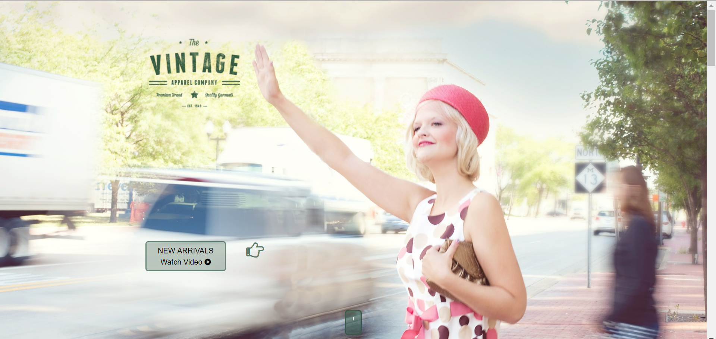
Hand coding from scratch
Modern, user friendly, interactive and responsive:

Slide 9
CSS the Basics
CSS: Cascading Style Sheets
We can separate mark-up and styling code
Link our styles to our webpage
Manipulate the layout of our webpage
Style different elements within our webpage
CSS3 History

Slide 10
CSS the Basics
CSS: Cascading Style Sheets
The best way to work with CSS is to link it into our head section of our html document
<head>
<link rel="stylesheet" type="text/css" href="css/myStyles.css“ />
</head>

Slide 11
CSS the Basics
CSS is composed of rules:
The Selector
The Declaration
Selector {
property: propertyValue;
}
p {
color: red;
}

Slide 12
CSS Selectors
p { color: red; }
Tag name
Class name
Element ID
Combine selector
Child selector
.productBox { width: 200px; }
#productID { font-size: 2em; }
.p.productSize { font-size: 2em; }
.productSize a { font-size: 2em; }
.productSize > a { font-size: 2em; }

Slide 13
CSS Selectors
a: link { color: blue; }
a: visited { color: yellow; }
a: hover { color: brown; }
a: active { color: white; }
Pseudo classes
Pseudo elements
p: first-child { color: red; }

Slide 14
Common CSS Properties
h2 { color: #444444; }
Color
Background
Background-colour
Background-image
Background-position
Can use shorthand
Text and fonts
footer { background-color: black; }
footer { background-color: black url(“pic1.jpg”) no-repeat fixed center; }
p { font-size: 2em; }

Slide 15
The CSS Box Model
Margin
Border
Padding
Content

Slide 16
Page Layout with CSS
CSS can specify how an element will be positioned
Inline:
The element should be displayed next to each other
<span>, <br>, <img>, <a>, <td>
Block:
They start on a new line and will take all the space it can horizontally, new content goes beneath
<div>, <h1>, <p>, <section>, <ul>, <article>, <nav>

Slide 17
Page Layout with CSS cont.
Float:
The browser will ignore the normal flow to place elements at the left or right of the content
It’s value can be left, right or none
Clear:
Stops the browser to set elements on the left or right of the content
Can also have the values left, right or none

Slide 18
Page Layout with CSS
Header (normal flow)
Sidebar
(float left)
Content (float left)
Footer (clear both)

Slide 19
Understanding The Cascade
CSS: Cascading Style Sheets
The cascade is what determines which styles are applied to an element.
CAUSES OF CONFLITING SELECTORS
SPECIFICITY
SOURCE
INHERITANCE
IMPORTANT

Slide 20
Understanding The Cascade
Style Sources
In a conflict, the last style declaration overwrites any previous conflicting selectors.
Developers
Online users
Browsers
Authors
Users
User Agents

Slide 21
Understanding The Cascade
Style Sources and Importance
The Browser gives styles different “weights” by sorting and applying styles in the following order:
User Agent Declarations
User Normal Declarations
Author Normal Declarations
Author Important Declarations
User Important Declarations

Slide 22
Understanding The Cascade
Inheritance
Body
Parent
Div
Aside
Child
Child
Div
Div
Descendants
Descendants
h2
p
p
p

Slide 23
Understanding The Cascade
Which Selector is More Specific
Least Specific
Universal Selectors
*
Type Selectors
p, h1, ul, a, div, section
Class Selectors
.mainPage, .actionButton
Attribute Selectors
Input[type=“text”]
Pseudo-Selectors
:hover, :active, :focus
ID Selectors
#myModal, #shopping
Inline Selectors
<p style=“color=blue”>
Most Specific

Slide 24
Understanding The Cascade
Which Selector is More Specific
#myModal .mainPage nth-of-type(2) h2
121
Larger number wins
#shopping #salesContainer div:first-child
211
0
2
1
1
0
1
2
1
Inline styles
IDs
Classes, attributes, pseudo-classes
Elements and pseudo-elements

Slide 25
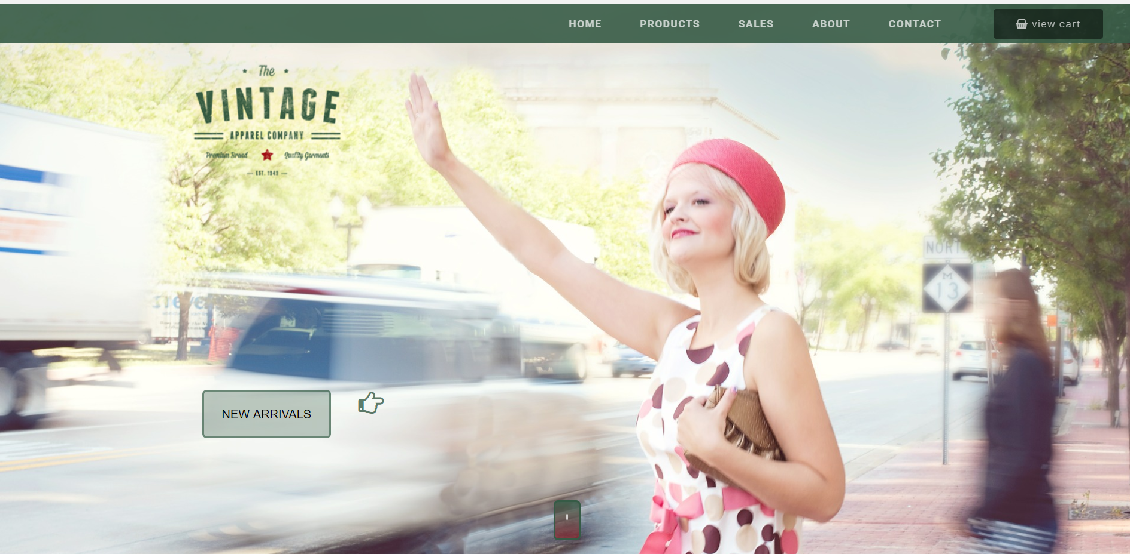
Apply CSS to our Case Study

